Slide 1


No To Drugs

Slide 2

Drug Facts
Nearly 841,000 people have died since 1999 from a drug overdose (CDC, n.d.)
In 2019 4,777 adolescence died from drug overdoses(NIH)
Marijuana is occasionally mixed with other dangerous substances.
Young individuals who smoke marijuana have been discovered to have abnormalities in the brain related to emotion, motivation, and decision making, according to studies.

Slide 3

Why People Do Drugs
Addiction
Family History
Self medication
Canadian Centre for Addictions, (2020)
Everyone is doing it
It seems like fun
I could relax
I could fit in
(Narconon, 2016)

Slide 4
Problems Drugs Cause
Loss of Job
Loss of family and friends
Homeless
Criminal Activity
Dropping out of school
Loss of life

Slide 5

Marijuana user Testimonies
https://youtu.be/IHX7zQrBEG8

Slide 6
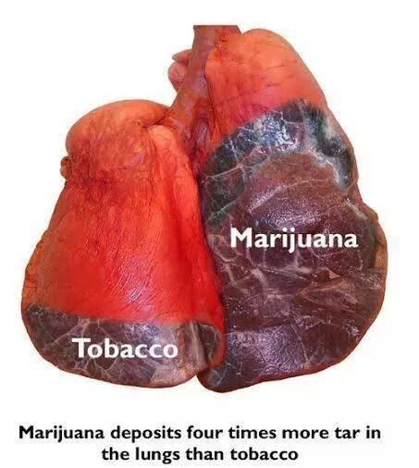
Marijuana
Short term marijuana use problems
Memory problems
Severe anxiety
Hallucinations
Loss of sense of personal identity
Increased Heart rate (Risk of stroke or heart attack).
Impaired coordination

Slide 7
Marijuana
Long term marijuana use problems
Decrease in IQ
Poor school performance
Impaired thinking
Addiction
Potential development of opioid abuse
Relationship problems
Antisocial problems
stealing
Paranoid difficulties
Greater chance of being unemployed

Slide 8
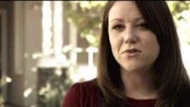
Alcohol Abuse
https://youtu.be/DoqXsOE_O4c

Slide 9
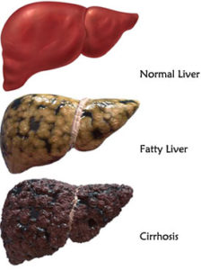
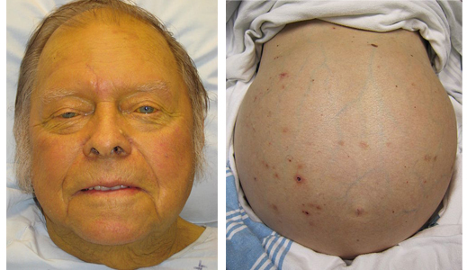
Alcohol
The liver is unable to get ride of poisons in your body. Liver failure causes yellow skin, enlarged stomach, stomach pain, leg swelling, dark urine color, nausea, and vomiting. These are all symptoms of this condition.

Slide 10

Alcohol
Short Term Effects of Alcohol
Slurred speech
Drowsiness
Vomiting
Diarrhea
Upset stomach
Headaches
Blackouts
Breathing Difficulties
Distorted vision and hearing
Decreased awareness
Unconsciousness
Anemia
Coma

Slide 11
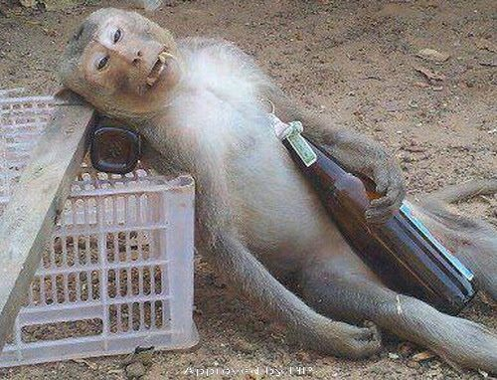
Alcohol
Long Term Effects of Alcohol
Unintentional Injuries
such as car crash, burns,
falls and drownings.
Intentional injuries such as firearm injuries, sexual assault, domestic violence.
On the job injuries
Family problems
Alcohol poisoning
High blood pressure, stroke
Liver disease
Nerve damage
Permanent brain damage
Stomach ulcers

Slide 12
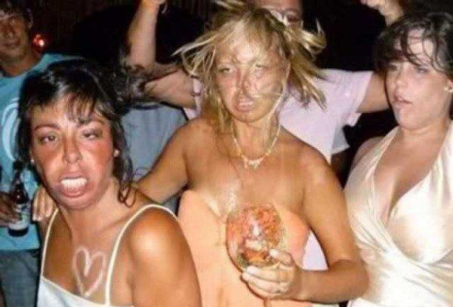
Alcohol
Long Term Effects of Alcohol
Low vitamin B levels can cause amnesia, lack of interest, and disorientation.
Gastritis ( inflammation of the stomach walls).
Malnutrition
Cancer of the mouth

Slide 13
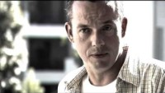
Pain Killers
https://youtu.be/YAHVESjVkWs

Slide 14
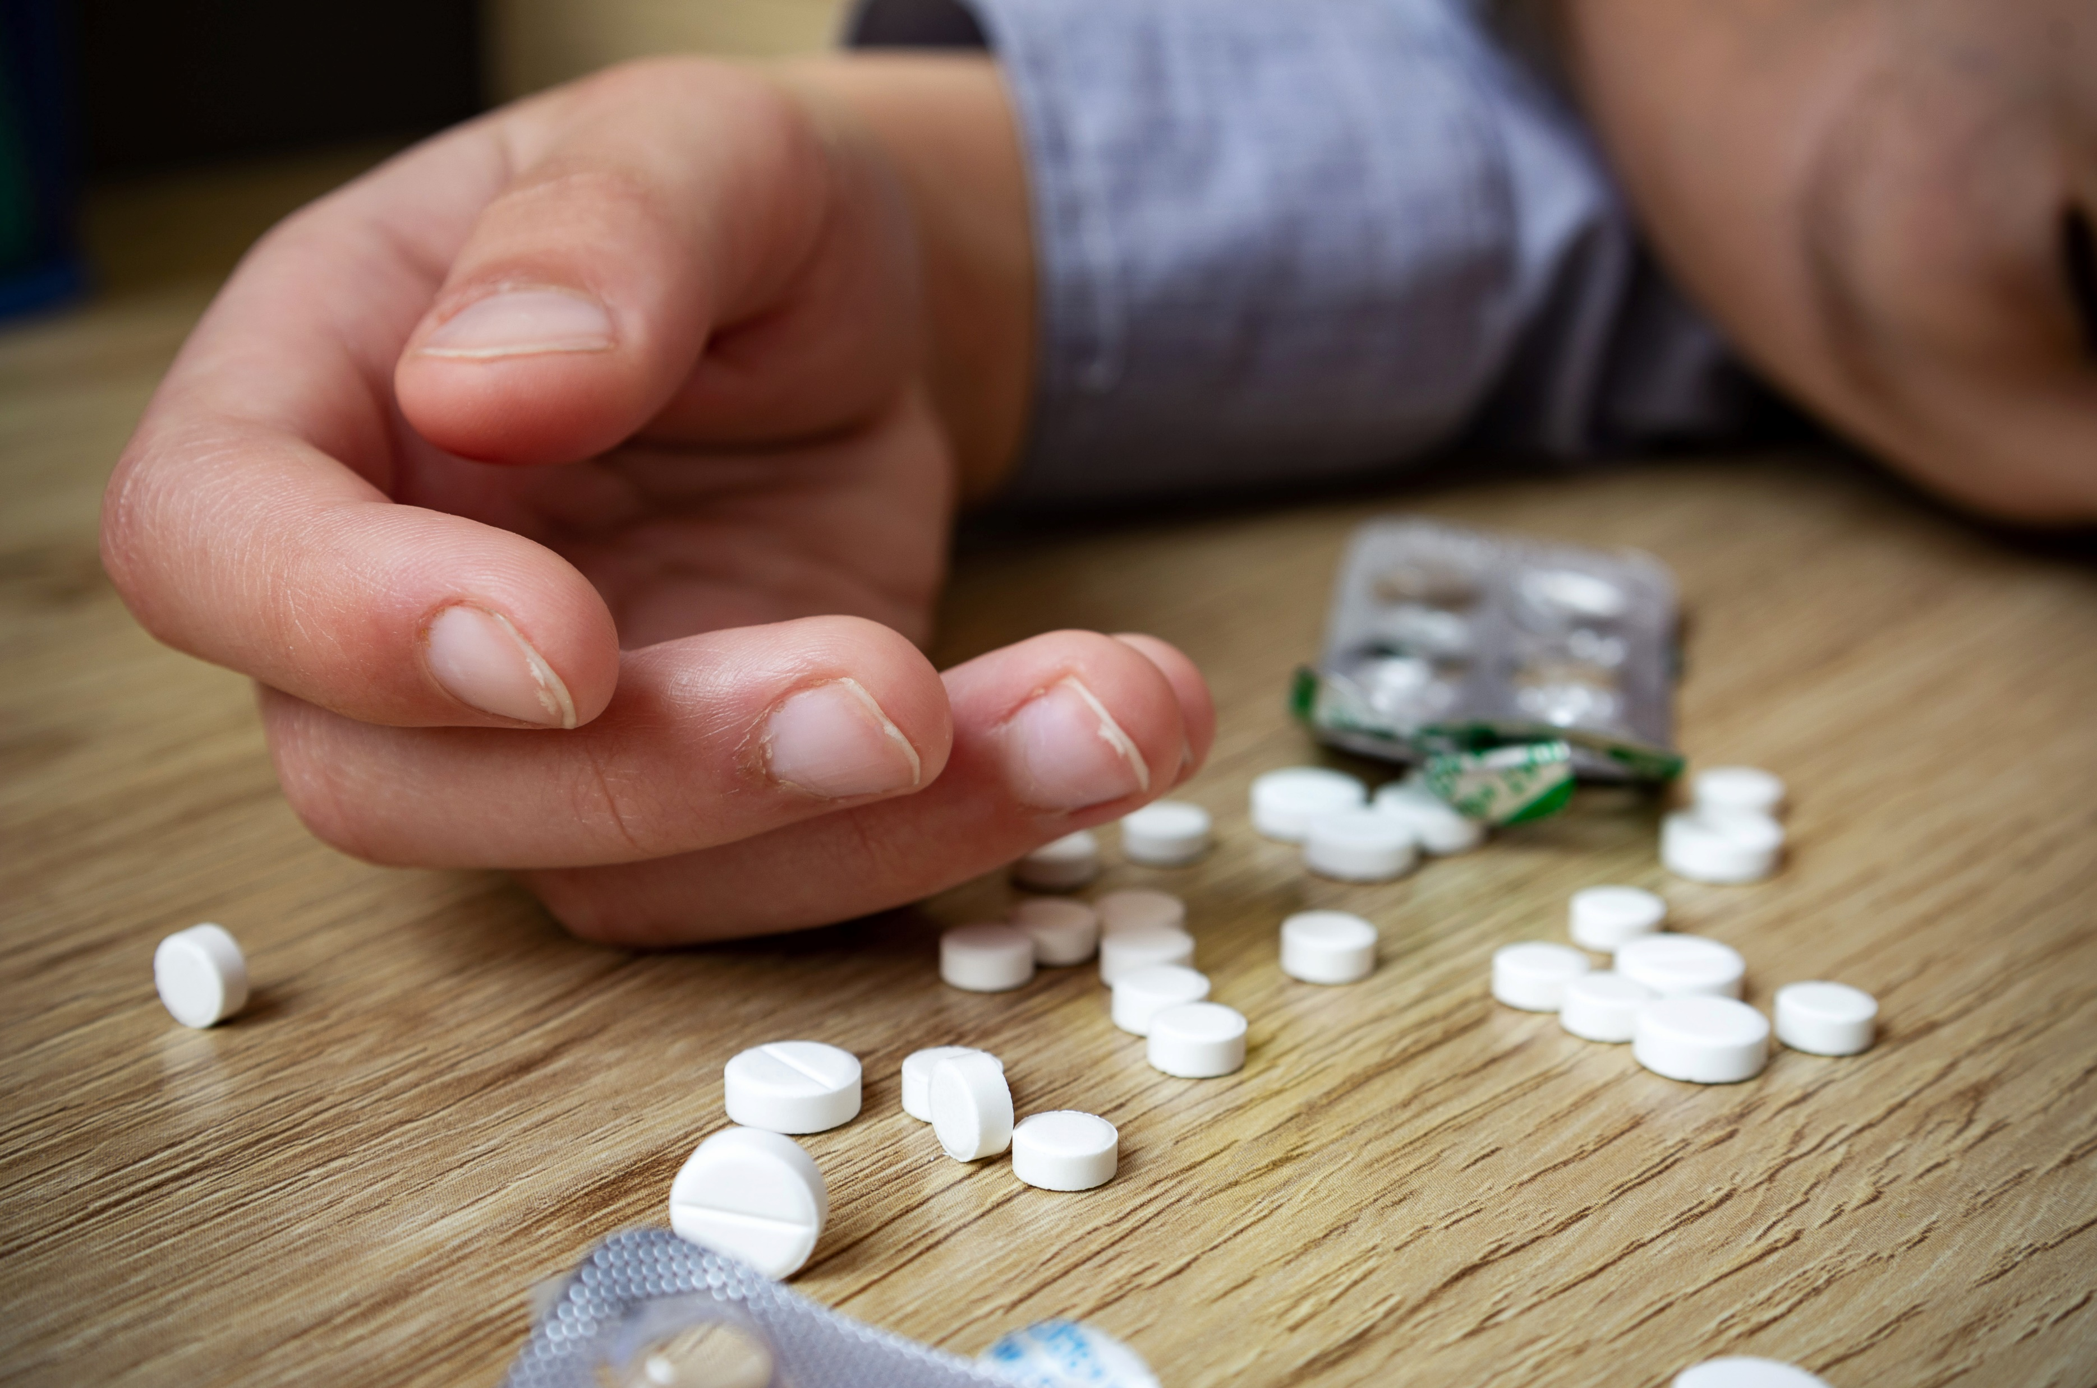
Pain killer Use Effects
Unconsciousness
Respiratory
Depression
Increased risk of heart attack
Coma
Death
Constipation
Nausea
Vomiting
Dizziness
Confusion
Addiction

Slide 15
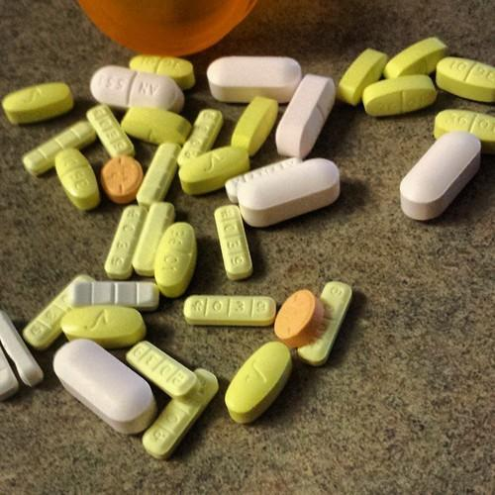
Pain Killer Effects
Caution! Symptoms of drug abuse
Have more personality shifts
Socially withdrawn
Visiting multiple more doctors in search of medications
Ignore responsibilities
Increased sensitivity to the surroundings, which causes blackouts and forgetfulness.
defensive

Slide 16

Cocaine
https://youtu.be/FHDKHKixKdY

Slide 17

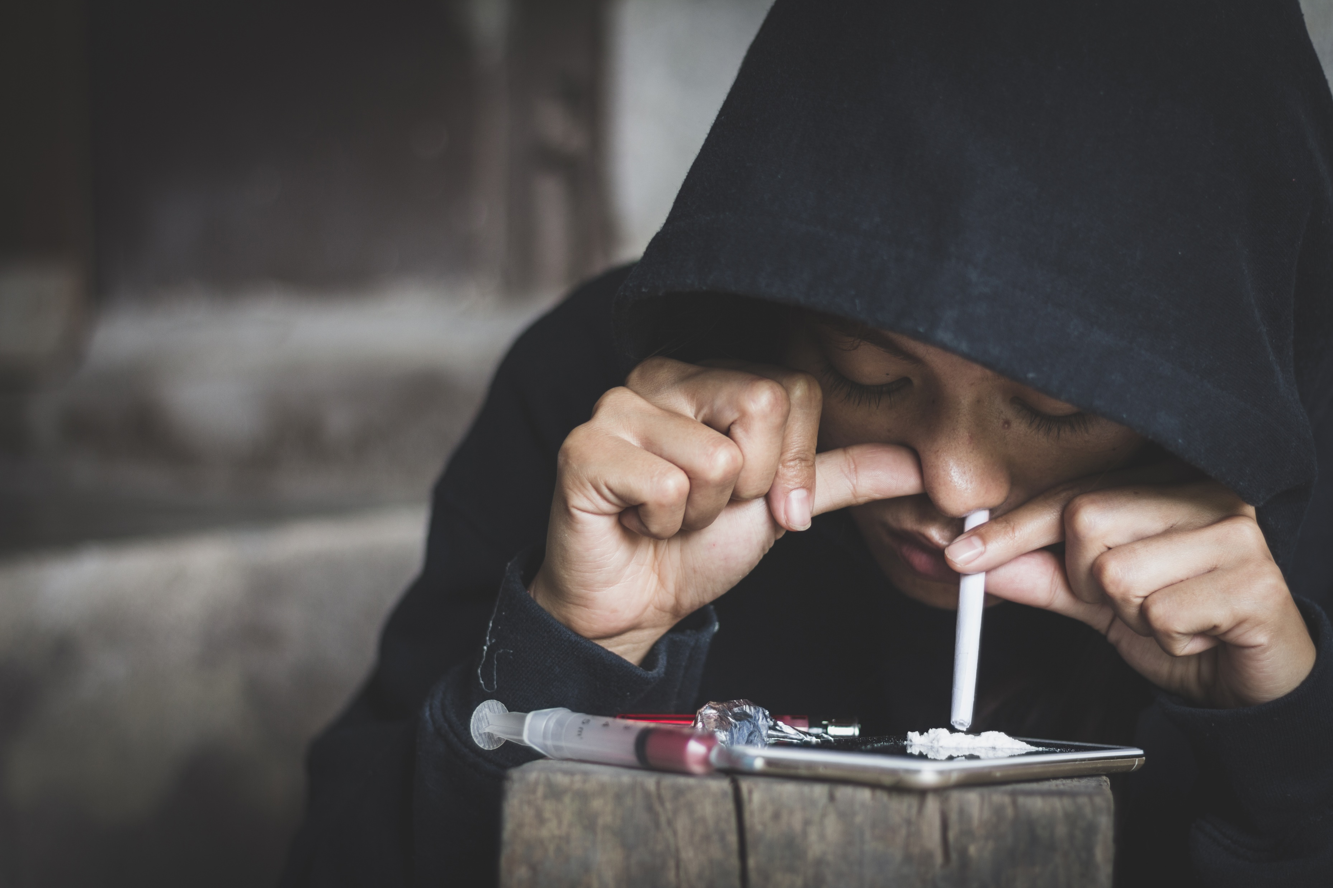
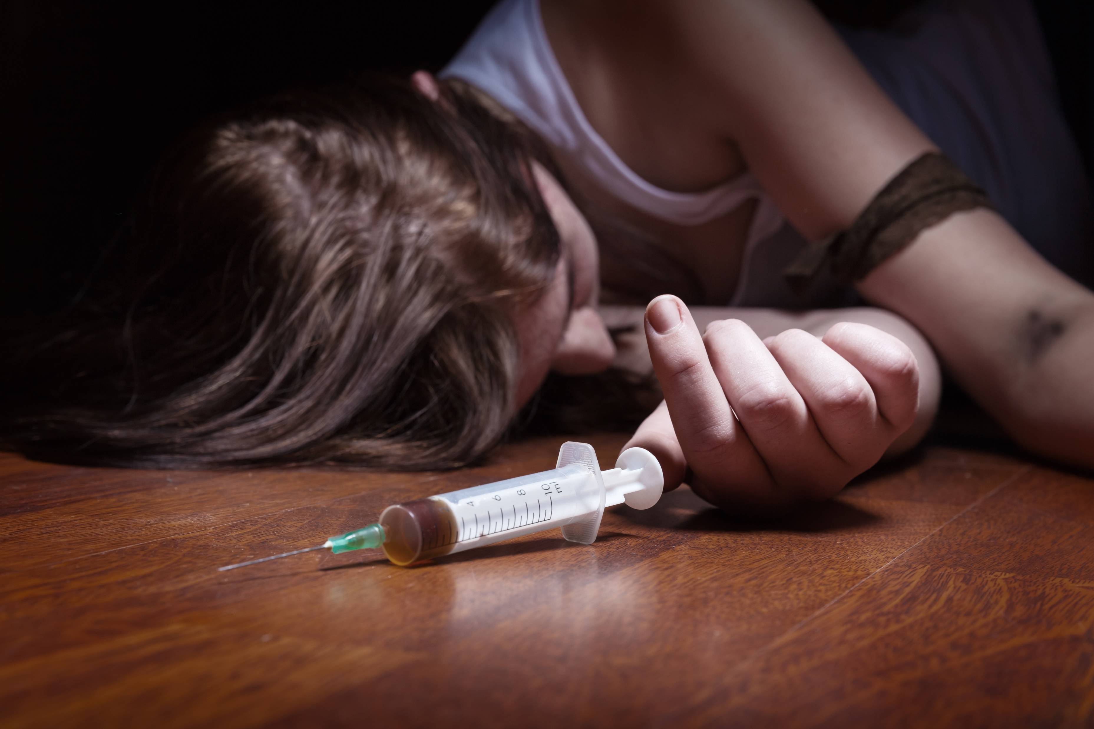

Slide 18
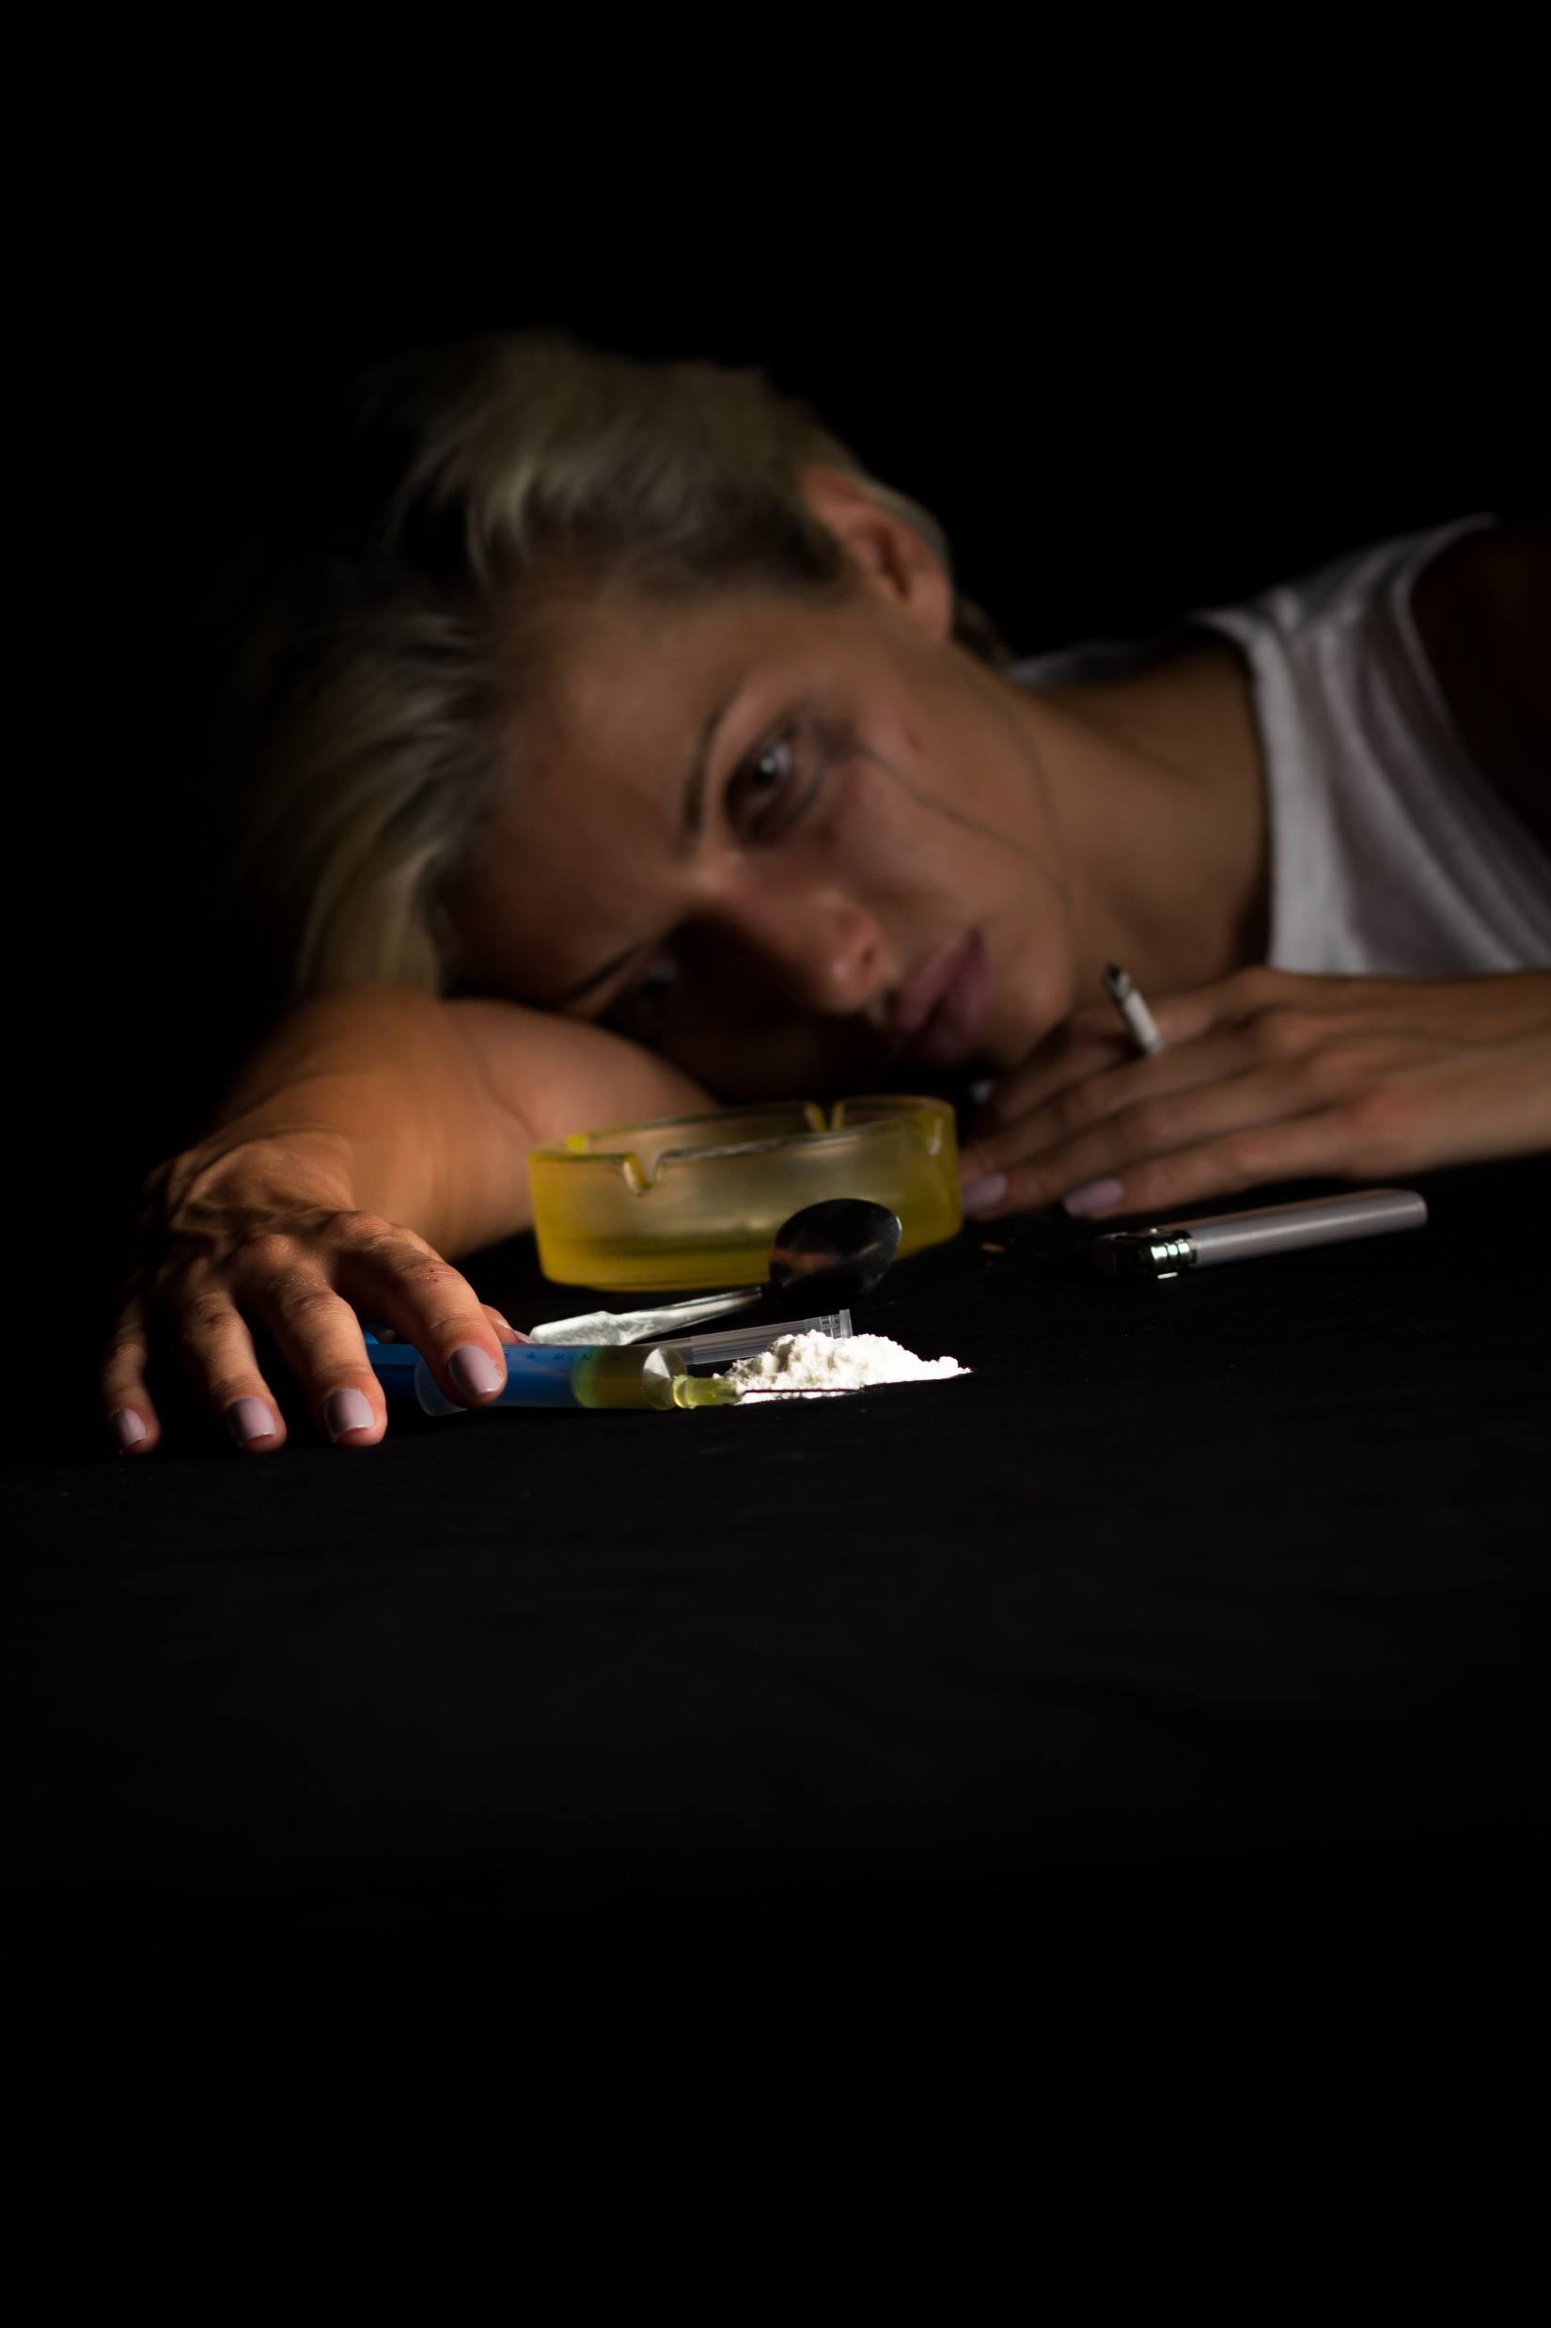
Cocaine Short Term Effects
Loss of appetite
Increased heart rate, blood pressure,
body temperature
Contracted blood vessels
Increased rate of breathing
Dilated pupils
Nausea
Hyper-stimulation
Bizarre, erratic, sometimes violent behavior
Intense euphoria
Anxiety and paranoia
Depression
Intense drug craving
Panic and psychosis

Slide 19
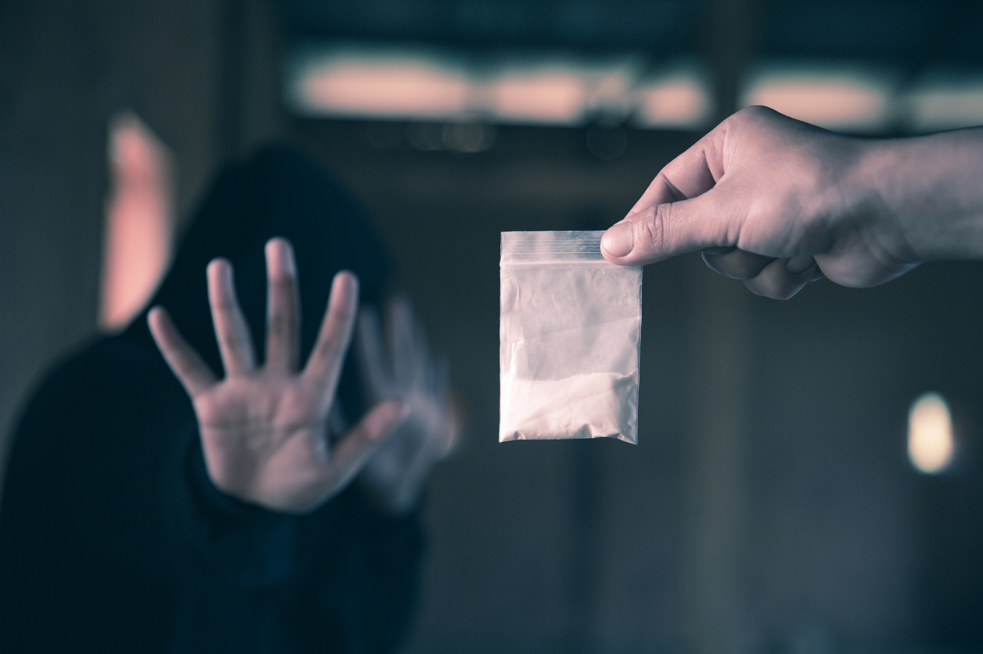
Cocaine Short Term Effects
Convulsions, seizures and sudden death from high doses.
Hallucinations, hyper-excitability, irritability

Slide 20
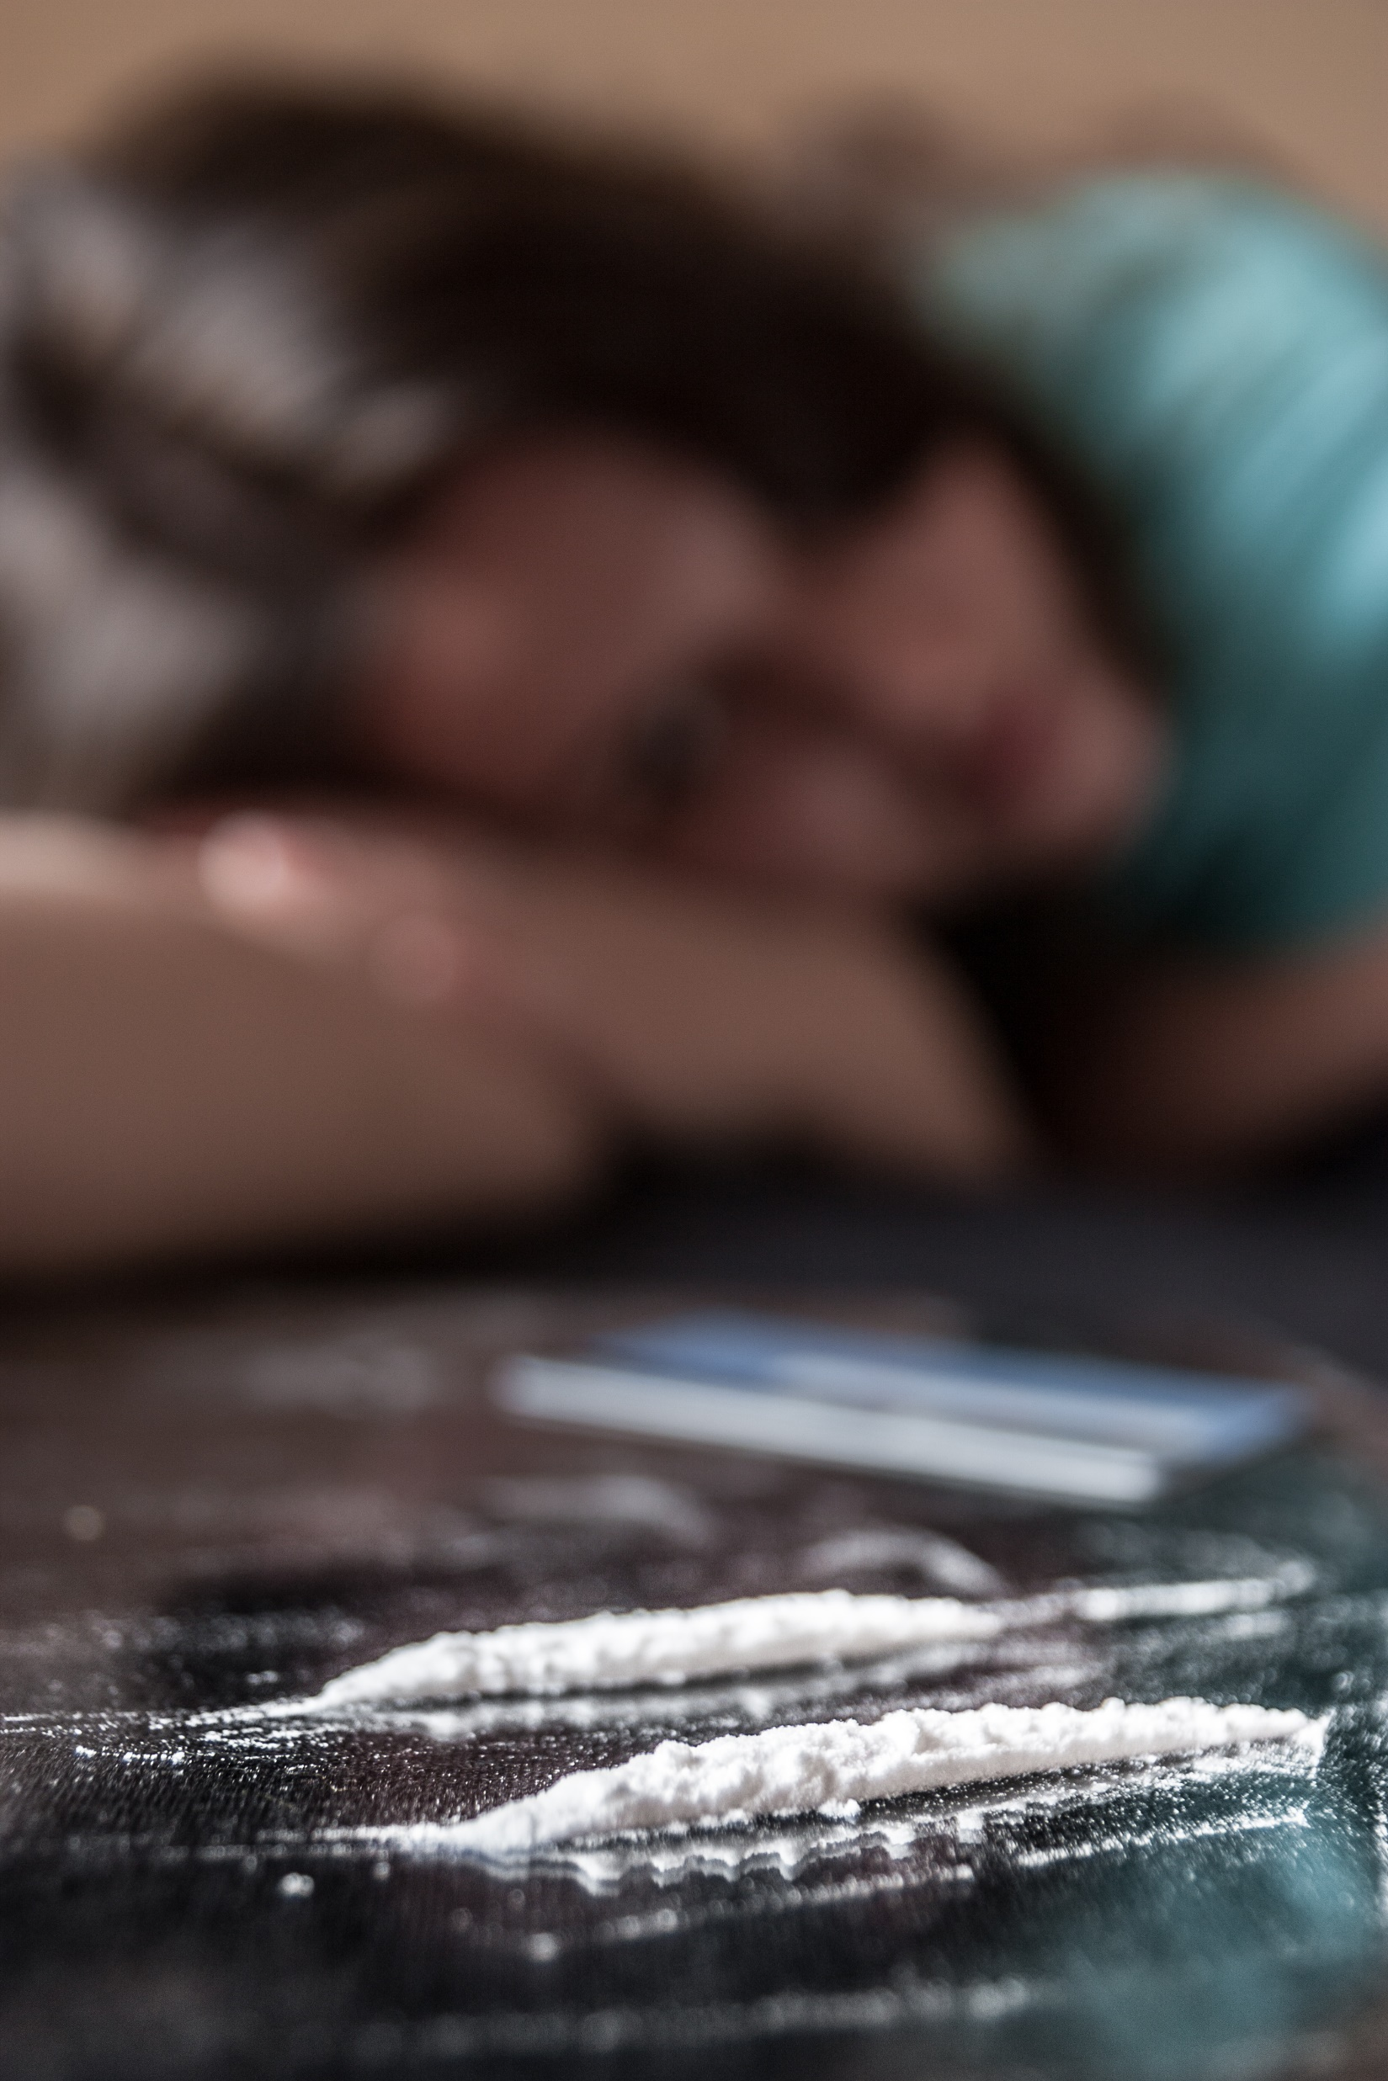
Cocaine Long Term Effects
Permanent blood vessel damage to the heart and brain
High blood pressure leading to possible strokes and heart attacks
Liver, kidney and lung damage
Destructive nose tissue damage if snorted
Respiratory failure if smoked
Infections if injected into the veins
Malnutrition, weight loss

Slide 21
Cocaine Long Term Effects
Sexual problems-reproductive damage and infertility
Disorientation, loss of interest,
Irritability and mood disturbance
Increased frequency of risky behavior
Delirium or psychosis
Severe depression
Tolerance and addiction

Slide 22

Crystal Meth
https://youtu.be/fuyX1XKxX_s

Slide 23
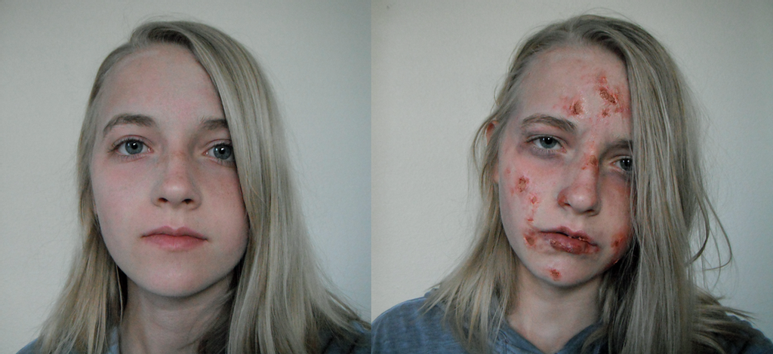
Crystal Meth

Slide 24
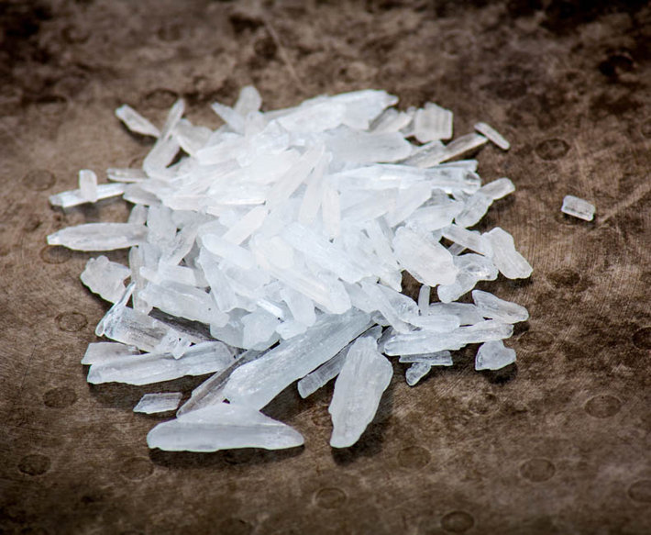
Crystal Meth Short Term Effects
Loss of appetite
Increased heart rate, blood pressure, body temperature
Dilated pupils
Disturbed sleep patterns
Nausea

Slide 25
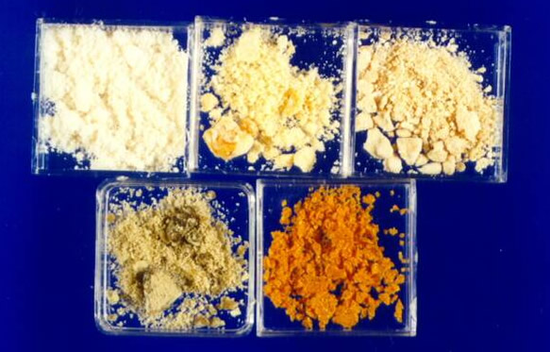
Crystal Meth Short Term Effects
Bazar, erratic sometimes violent behavior
Hallucinations, hyper-excitability, irritability
Panic and psychosis
Convulsions and seizures and death from high doses.

Slide 26
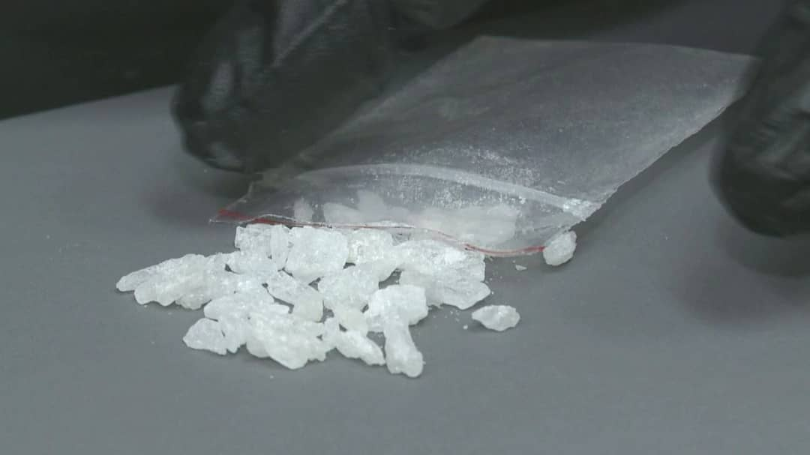
Crystal Meth Long Term Effects
Permit damage to blood vessels that cause brain damage, heart attacks and strokes.
Liver, Kidney and lung disease
Tissue nose damage if snorted
Respiratory problems if smoked
Infections if injected
Malnutrition and weight loss

Slide 27
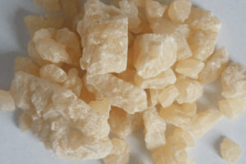
Crystal Meth Long Term Effects
Severe tooth decay
Disorientation, loss of interests, confusion and exhaustion
Strong psychological dependence
Psychosis
Depression
Damage to the brain like Alzheimer's.

Slide 28
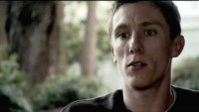
Ecstasy
https://youtu.be/2J8ORsBuM5U

Slide 29
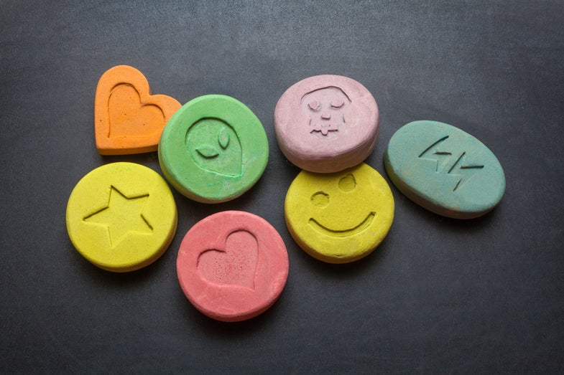
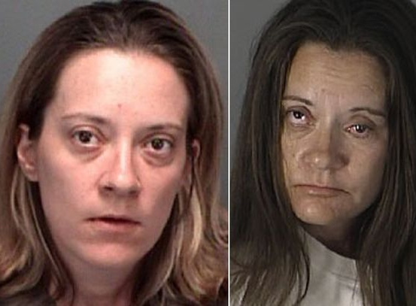
Ecstasy Before and After Photos

Slide 30
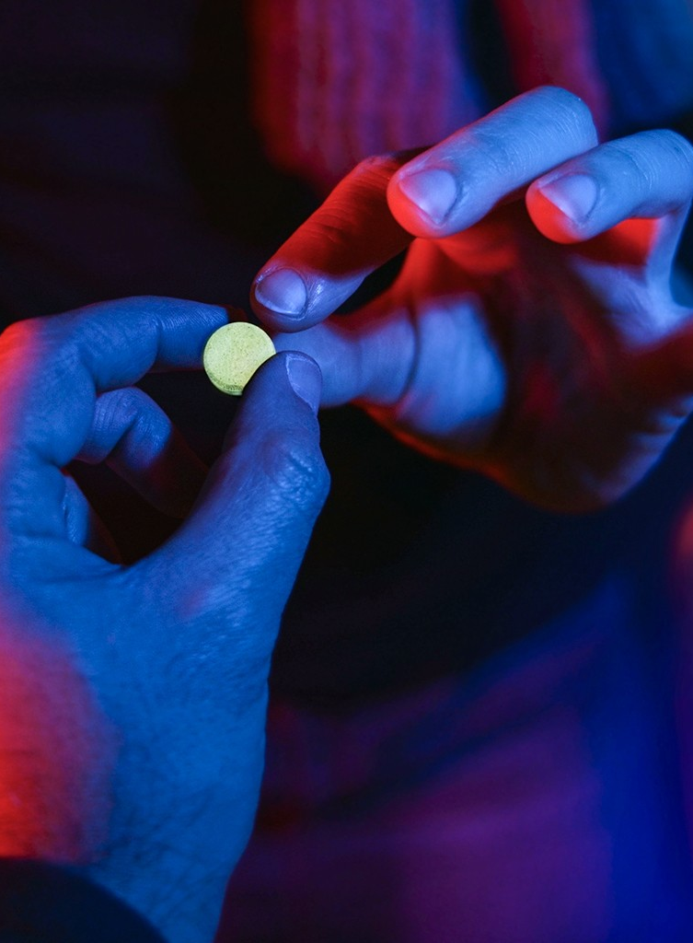
Short Term Effects of Ecstasy
Impaired Judgment
False sense of affection
Confusion
Depression
Sleep Problems
Severe Anxiety
Paranoia

Slide 31
Short Term Effects of Ecstasy
Drug cravings
Muscle tension
Faintness, chills
Involuntary teeth clenching
Blurred vision
Nausea

Slide 32
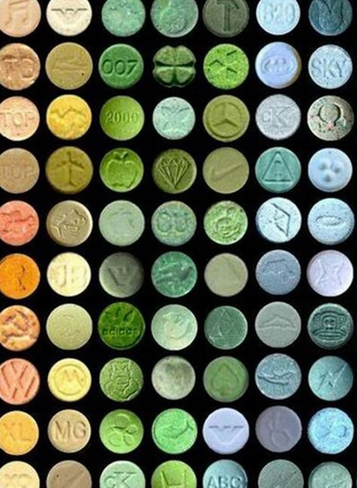
Long Term Effects of Ecstasy
Long-lasting brain damage affecting thought and memory.
Damages to parts of the brain that effect learning, sleep, and emotion
Degenerative nerve diseases- affects activities, such as balance, movement, talking, breathing, and heart function.
Depression, anxiety, memory loss
Kidney failure

Slide 33
Long Term Effects of Ecstasy
Psychosis-(loss of reality)
Cardiovascular collapse-(loss of blood flow to the heart)
Convulsions
Hemorrhaging
Death

Slide 34
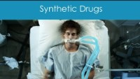
Synthetic Drugs
https://youtu.be/yDNit9U2I0A

Slide 35
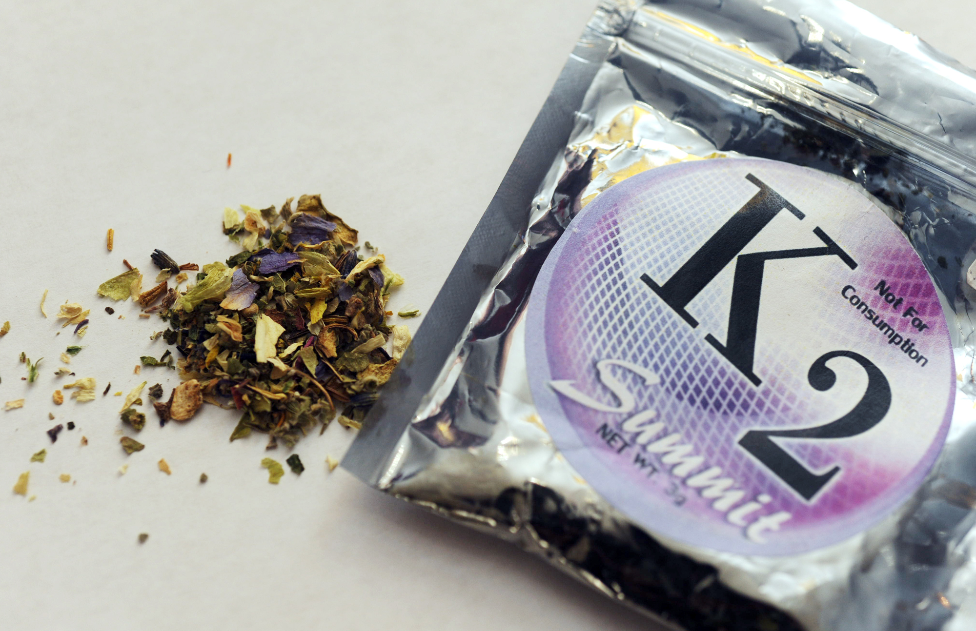
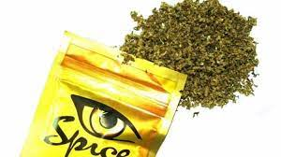

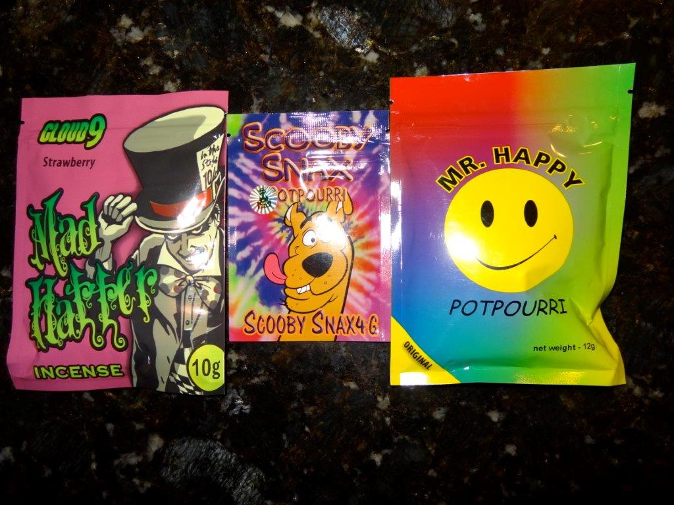
5175710001269267

Slide 36

Short Term Effects of Synthetic Drugs
Unresponsiveness
Loss of Consciousness
Confusion
Altered time sense
Extreme anxiety
Panic attacks
Severe paranoia
Delusions
Hallucinations
Psychosis
Potential suicide

Slide 37
Effects on the Body of Synthetic Drugs
Nausea and Vomiting
Heavy sweating
Uncontrolled/ spastic
body movements
Acute Kidney injury
Rapid heart rate
High blood pressure
Reduced blood supply to the heart
Heart attack
Convulsions
Seizures
Strokes

Slide 38

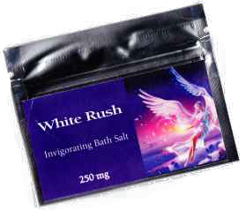
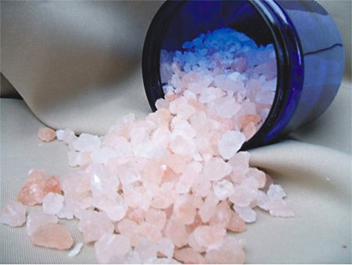
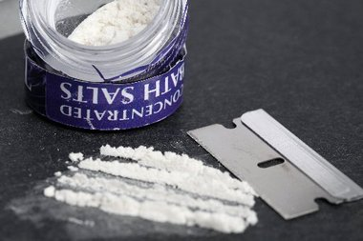
Bath Salts

Slide 39
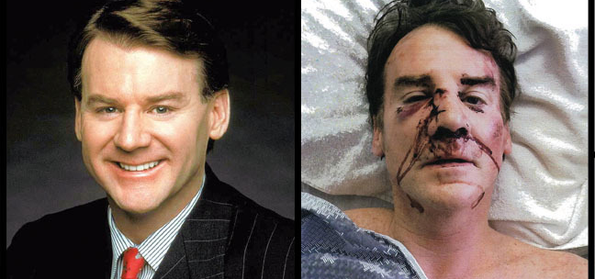
The Effects of Bath Salts

Slide 40
Bath Salts Short-Term Effects
Uncontrollable craving for the drug
Insomnia
False feeling of well being changing to paranoia
Nightmares
Depression
Severed agitation
Hallucinations and delusions

Slide 41
Bath Salts Short-Term Effects
Self-harm
Suicidal thoughts or suicide
Psychosis
Violent behavior

Slide 42
Bath Salts Effects on the Body
Skin Rash
Skin crawling sensation
Excessive sweating
High fever
Loss of appetite
Sexual dysfunction
Nosebleed and nose burn if snorting
Pain in the back of the mouth

Slide 43
Bath Salts Effects on the Body
Ringing or buzzing in the ears
Teeth grinding
Muscular cramping or tension
Numbness/ Tingling
Dizziness
Blurred Vision
Rapid movement of the eyes
Chest pain and heart attacks

Slide 44
Bath Salts Effects on the Body
Headache
Seizures
Brain herniation
Death

Slide 45

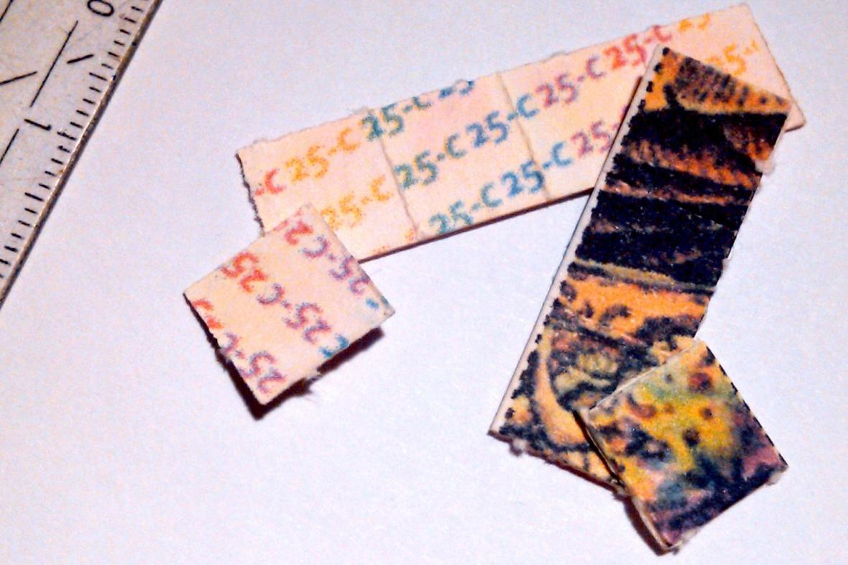
N-Bomb

Slide 46
N-Bomb Short Term Effects
Visual and auditory hallucinations
Confusion and disorientation
Scrambled Communications
Aggression
Paranoia and panic
Agitation
Insomnia

Slide 47
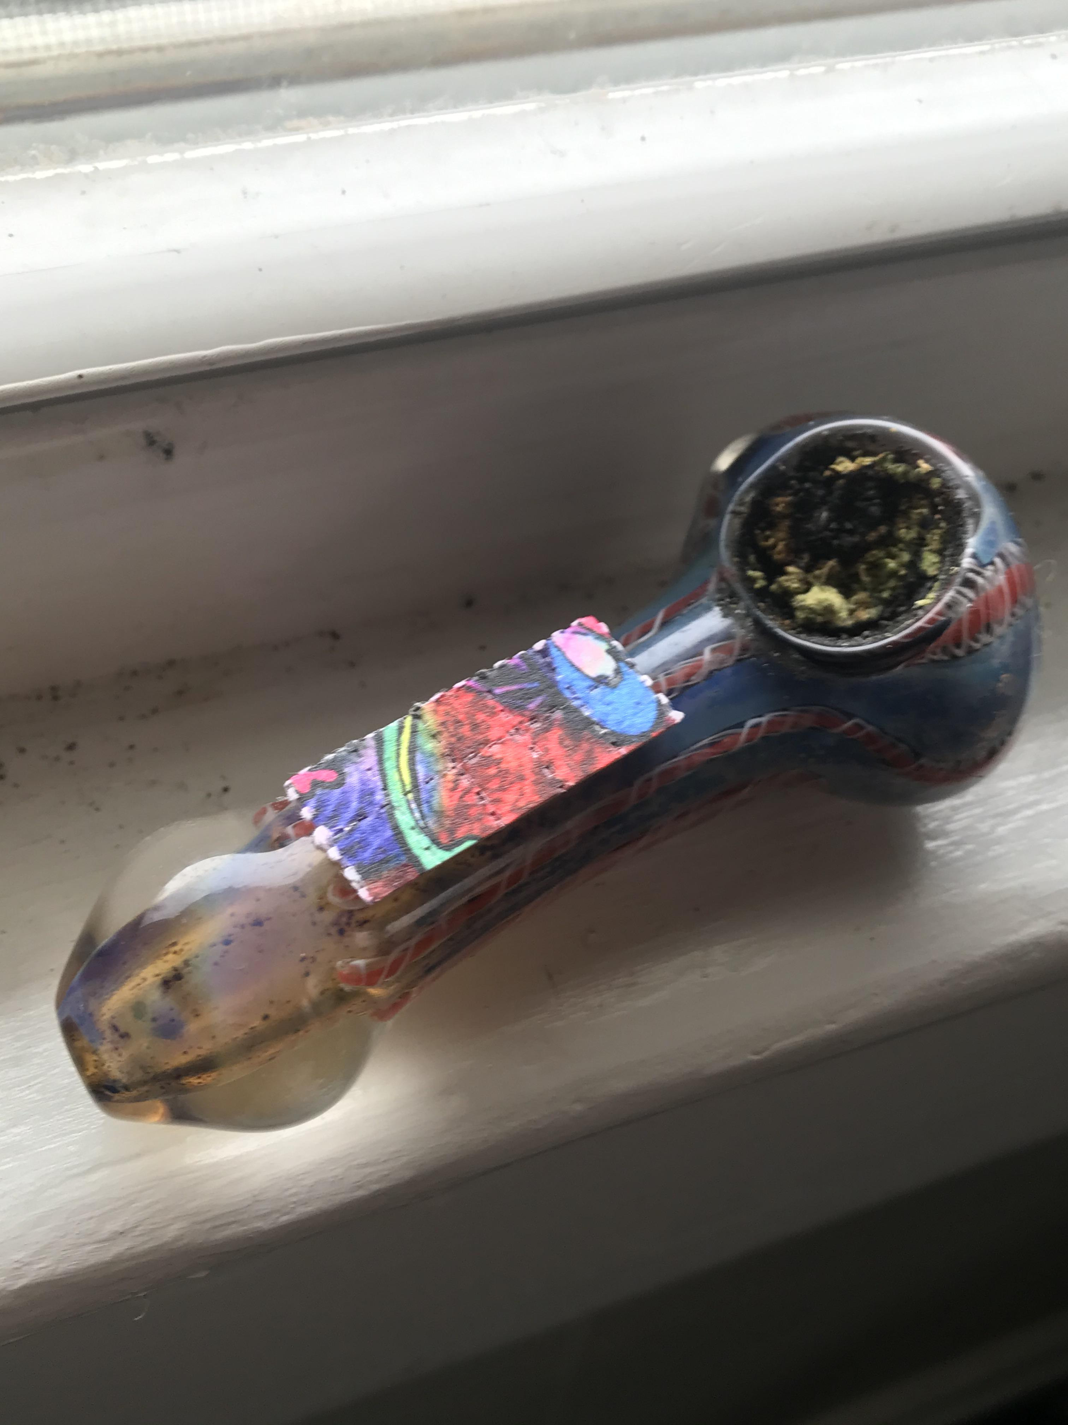
N-Bomb Effects on the Body
Shaking
Nausea/ Vomiting
Fainting and loss of consciousness
Muscle spasms
Difficulty breathing
High white cell count
Rapid heart rate
High Blood pressure

Slide 48
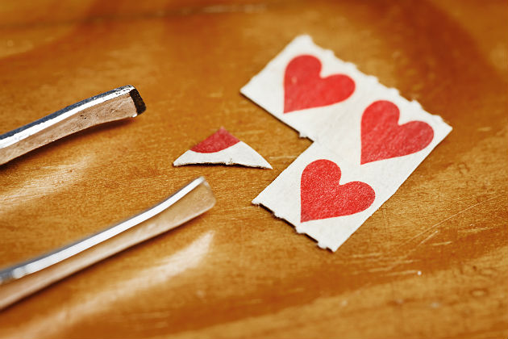
N-Bomb Effects on the Body
High level in the body leading to coma and death
High fever
Seizures/involuntary flailing and thrashing
Kidney failure
Heart attack
Respiratory failure
Bleeding in the brain

Slide 49
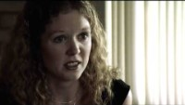
Heroin
https://youtu.be/RGuOlYTqi0E

Slide 50
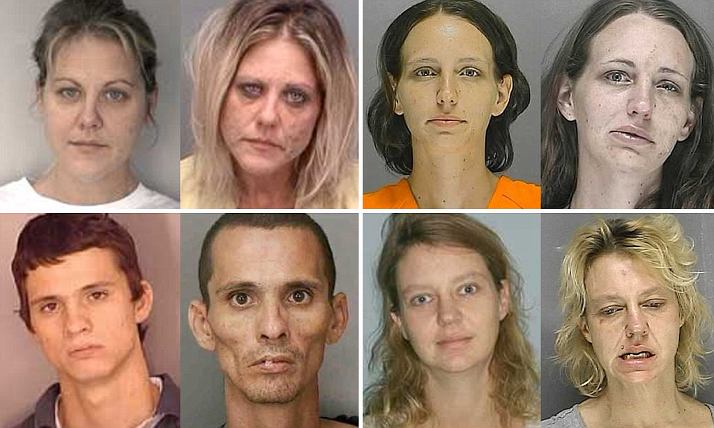
Heroin Before and After Photos

Slide 51
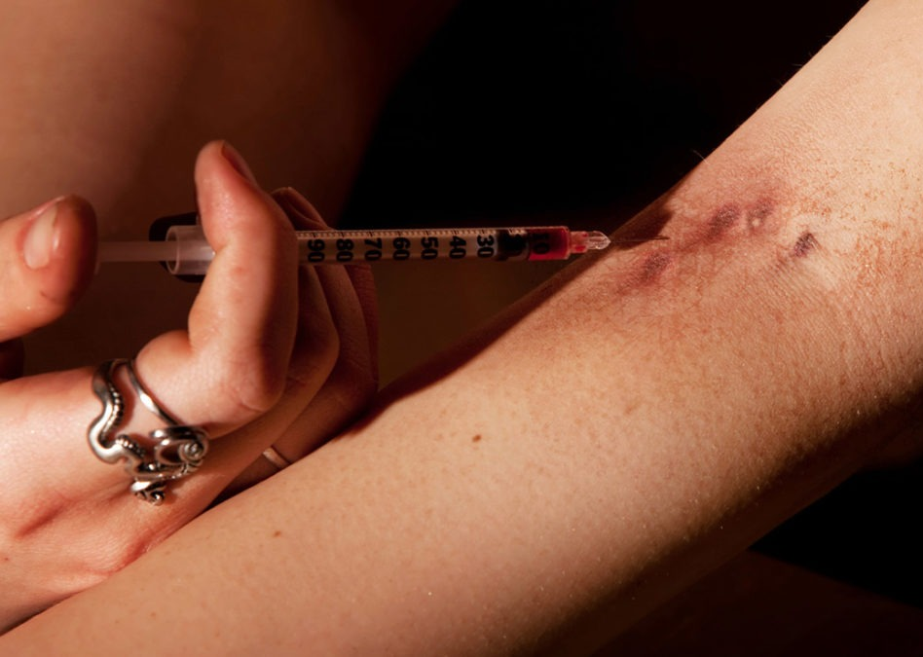
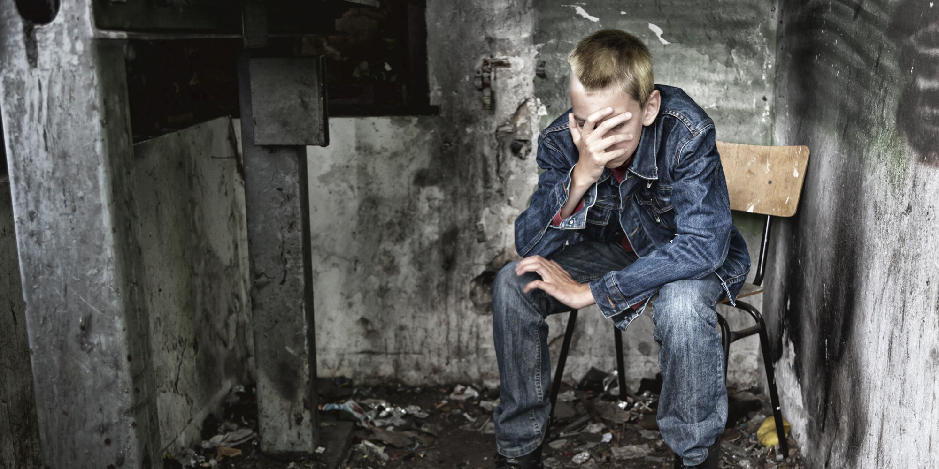
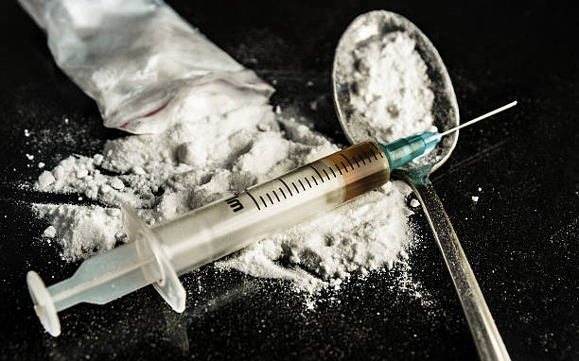
Heroin

Slide 52

Heroin Short-Term Effects
Rush
Slowed breathing
Clouding mental function
Nausea and vomiting
Sedation; drowsiness
Hypothermia

Slide 53
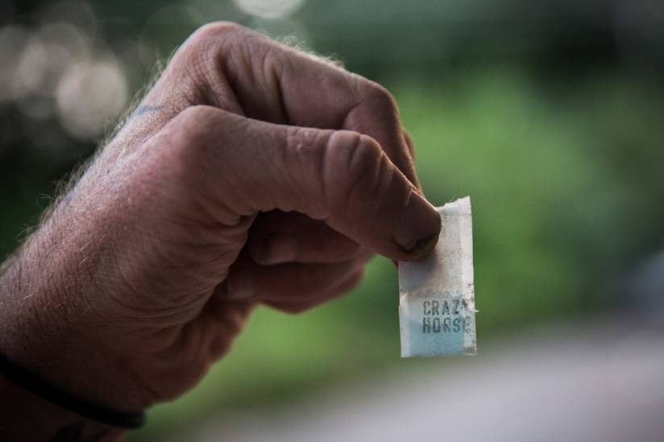
Heroin Long-Term Effects
Bad teeth
Constipating
Cold sweats
Itching
Weakening of the immune system
Coma
Respiratory illnesses

Slide 54
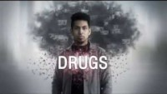
https://youtu.be/V6qgjbHDAD4

Slide 55
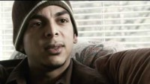
Final Word
https://youtu.be/8cIA24eQ5B8

Slide 56




